Slide 1

Insurance Analytics
Presented By – Group No. 5
Members:-
Siddhesh Atkar
Samruddhi Dere
Jayashree O
Pallavi Vemula
Donakanti Sai Sri
Arun Banoth
Revanth Peethala
Tools Used: Excel, Tableau, Power BI, MySQL

Slide 2
INTRODUCTION
Insurance companies generate large volumes of data related to policies, customers, claims, and payments. However, raw data alone does not provide meaningful insights unless it is properly analyzed.
This project focuses on converting insurance data into actionable business insights using key performance indicators (KPIs), enabling informed decision-making.

Slide 3

PROBLEM STATEMENT
Insurance data is complex and spread across multiple sources
Manual analysis is time-consuming and error-prone
Difficult to track:
Policy performance
Claims and payments
Revenue growth
Customer trends
Hence, a structured analytical approach is required.

Slide 4





OBJECTIVES OF THE PROJECT
Analyze overall policy and customer base
Understand demographic trends
Monitor claims and payment efficiency
Measure premium revenue growth
Support data-driven business decisions

Slide 5
LIST OF KPIs USED
Total Policies
Total Customers
Age Bucket Wise Policy Count
Gender Wise Policy Count
Policy Type Wise Policy Count
6. Policies Expiring This Year
Premium Growth Rate
Claim Status Wise Policy Count
Payment Status Wise Policy Count
Total Claim Amount

Slide 6

KPI 1: TOTAL POLICIES
Insight: Represents the total number of policies in the system.
Business Interpretation:
Indicates overall business size
Helps assess operational workload
Reflects market presence

Slide 7

KPI 2: TOTAL CUSTOMERS
Insight: Total number of unique customers holding one or more policies.
Business Interpretation:
Measures customer reach
Helps identify cross-selling opportunities
Indicates customer engagement

Slide 8
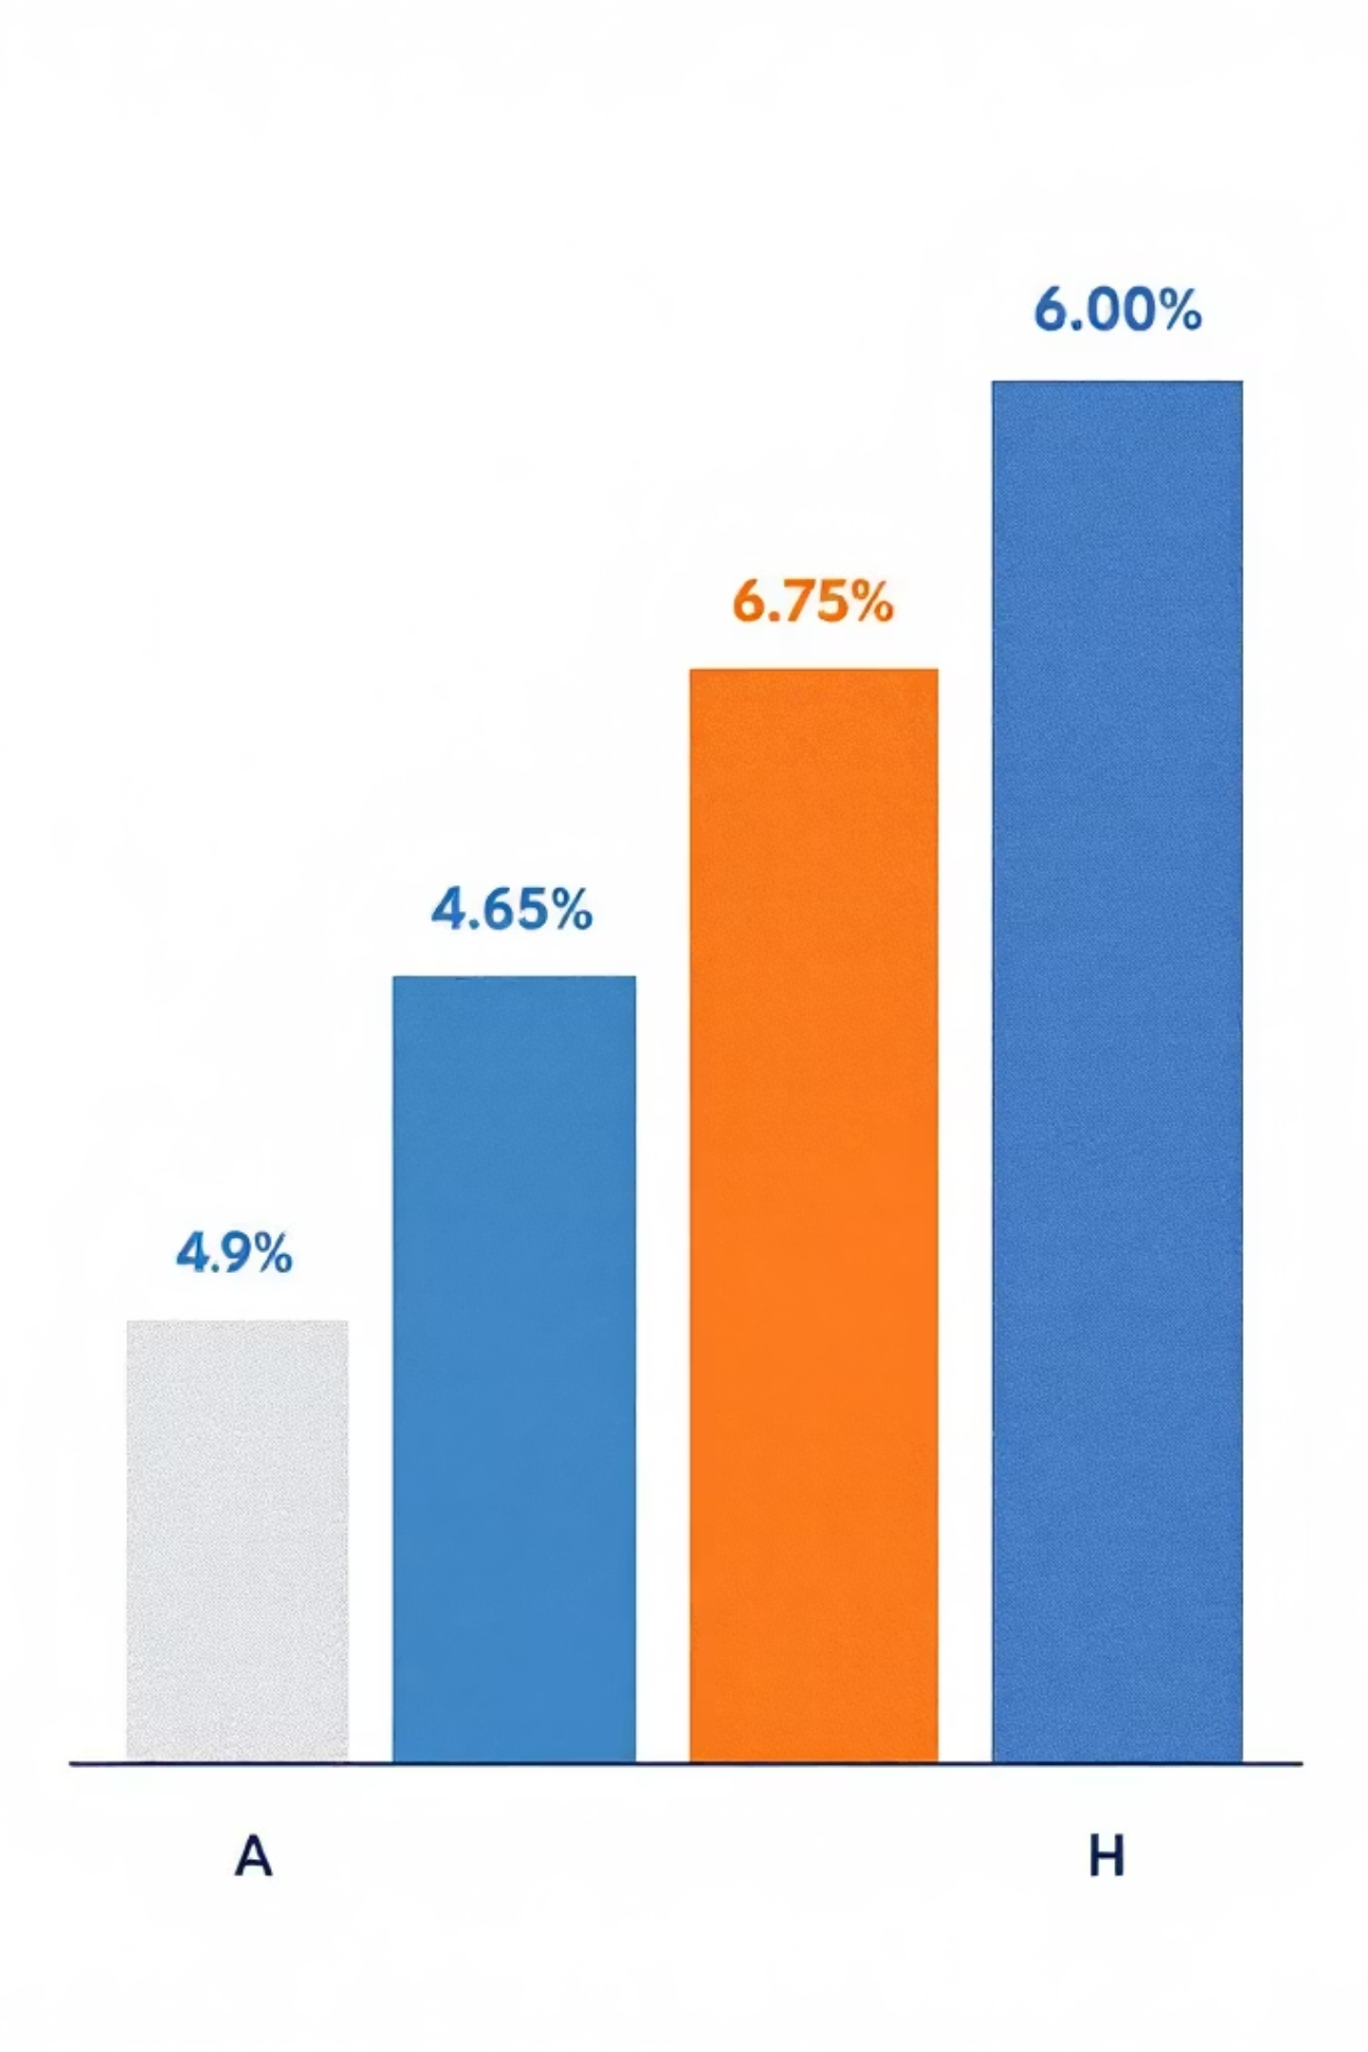
KPI 3: AGE BUCKET WISE POLICY COUNT
Insight: Distribution of policies across different age groups.
Business Interpretation:
Identifies dominant age segments
Helps design age-specific products
Highlights untapped customer groups

Slide 9

KPI 4: GENDER WISE POLICY COUNT
Insight: Shows policy adoption by gender.
Business Interpretation:
Reveals demographic trends
Supports inclusive policy design
Identifies gaps in market reach

Slide 10

KPI 5: POLICY TYPE WISE POLICY COUNT
Insight: Shows popularity of different policy types.
Business Interpretation:
Identifies revenue-driving products
Helps improve low-performing policies
Supports portfolio optimization

Slide 11

KPI 6: POLICIES EXPIRING THIS YEAR
Insight: Counts policies approaching expiry.
Business Interpretation:
Critical for renewal planning
Helps reduce policy lapses
Improves customer retention

Slide 12

KPI 7: PREMIUM GROWTH RATE
Insight: Measures year-on-year growth in premium revenue.
Business Interpretation:
Positive growth indicates business expansion
Negative growth signals strategic concerns
Supports forecasting and planning

Slide 13
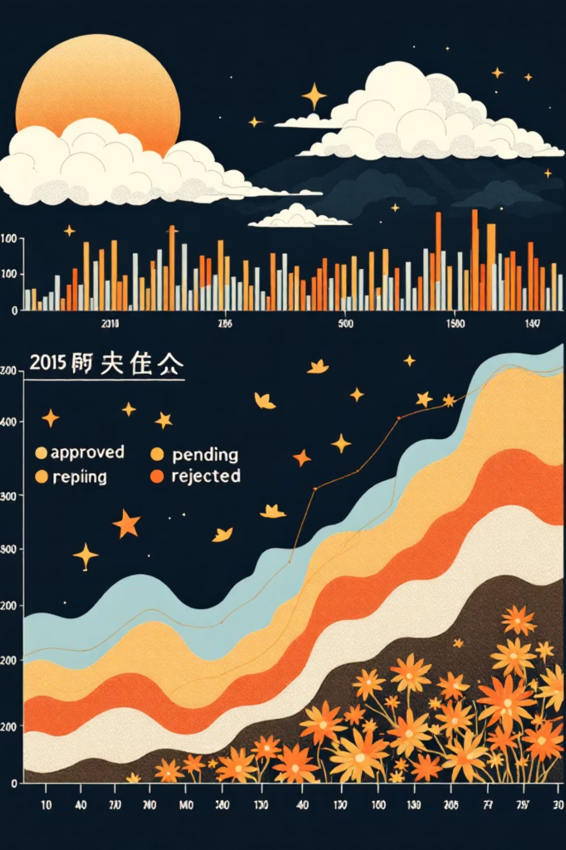
KPI 8: CLAIM STATUS WISE POLICY COUNT
Insight: Shows claim distribution by status.
Business Interpretation:
High approvals indicate efficient claim processing
Pending claims highlight operational delays
Rejections may point to policy clarity issues

Slide 14
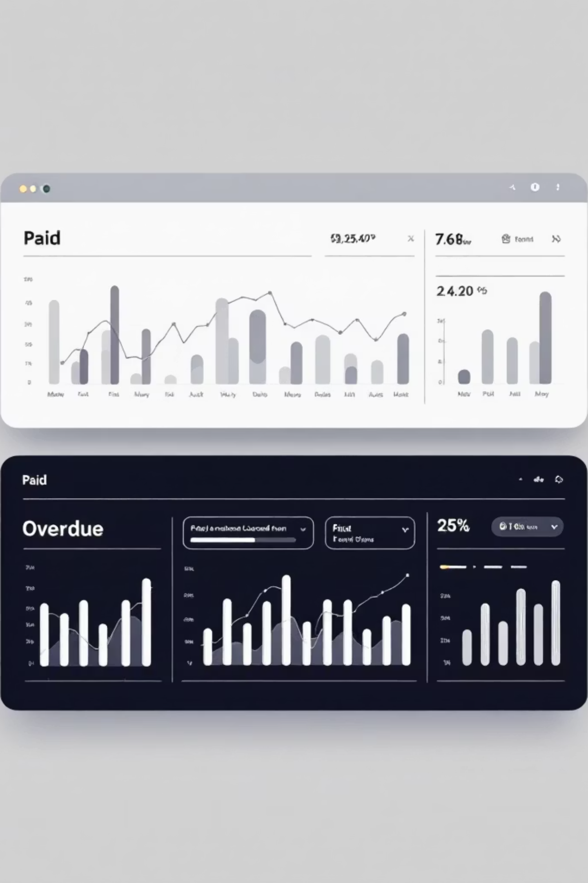
KPI 9: PAYMENT STATUS WISE POLICY COUNT
Insight: Categorizes policies based on payment status.
Business Interpretation:
Paid policies ensure healthy cash flow
Overdue payments highlight financial risk
Helps improve payment compliance

Slide 15

KPI 10: TOTAL CLAIM AMOUNT
Insight: Total payout towards insurance claims.
Business Interpretation:
Indicates financial exposure
Helps in risk assessment
Supports premium pricing decisions

Slide 16
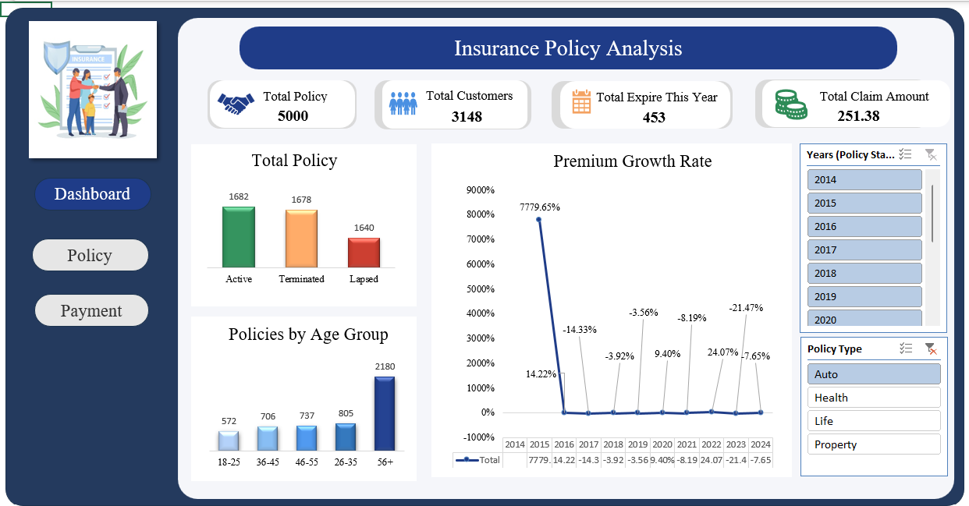
EXCEL DASHBOARD

Slide 17
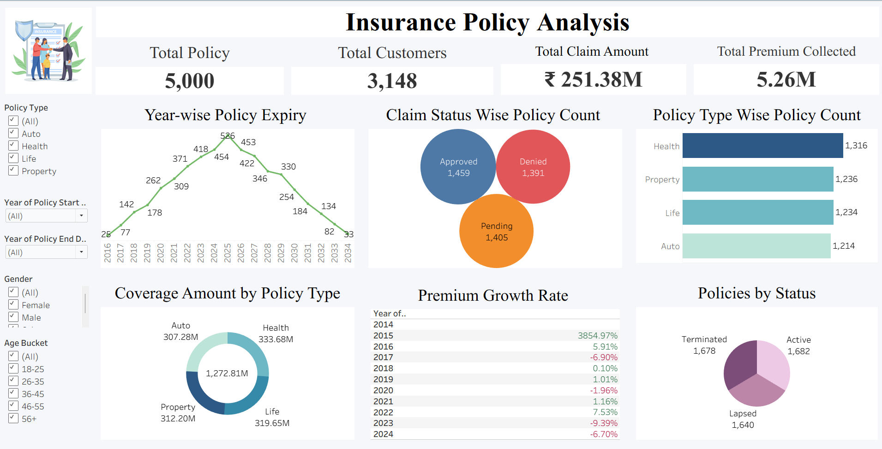
TABLEAU DASHBOARD

Slide 18
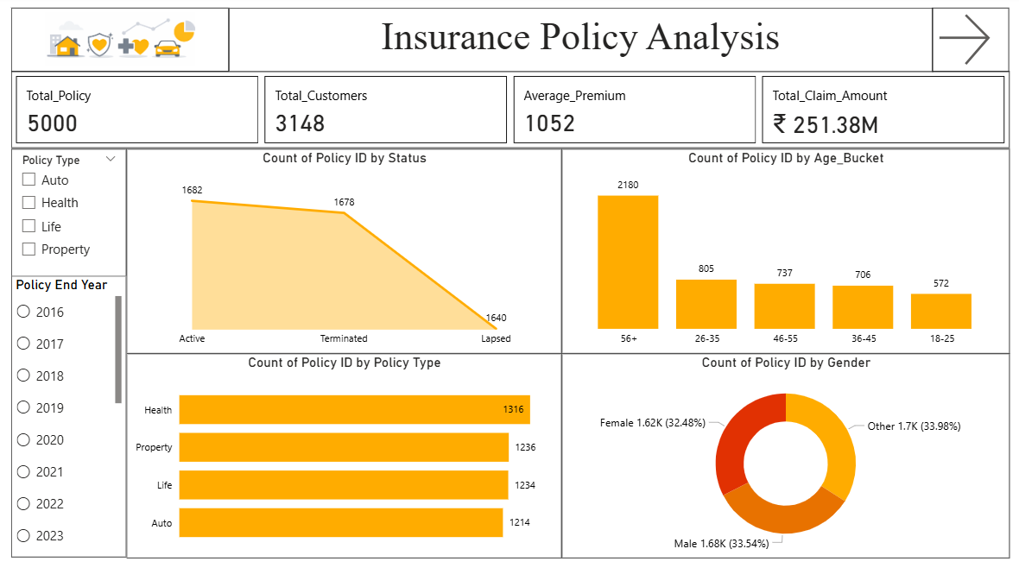
POWER BI DASHBOARD

Slide 19

CONCLUSION
Insurance KPIs help convert raw data into clear and actionable business insights.
Policy and customer analysis provides a strong understanding of market reach and customer behavior.
Demographic insights support better product design and targeted marketing strategies.
Premium growth analysis highlights overall business expansion and revenue performance.
Payment status insights help assess cash flow health and identify collection risks.
Claim-related KPIs reveal operational efficiency and areas needing process improvement.
Combined KPI analysis enables proactive, data-driven decision-making.
Overall insights support sustainable growth, risk management, and improved business performance.

Slide 20

THANK YOU !

